Slide 1


Mobile Application Development Laboratory
HOTEL BOOKING APP
220701198
Prarthana K
Mr. Bhuvaneswaran B, M.E.
Supervisor
Assistant Professor
Department of Computer Science and Engineering
Rajalakshmi Engineering College

Slide 2
Abstract
The "Smart Stay" Hotel Booking Application is a user-friendly mobile solution designed to simplify hotel booking for travelers. Developed using Android Studio and Kotlin, the app leverages Google Maps API to help users discover hotels near their current or specified location. It offers real-time room availability, secure booking, and detailed hotel information, including pricing, ratings, and amenities. Smart Stay integrates Android Jetpack components such as Live Data, View Model, and Room Database, following the MVVM architecture for clean code and scalability. With a sleek, Material Design-based UI, the app provides an intuitive and seamless experience, making hotel bookings quick, efficient, and hassle-free for users on the go.

Slide 3
Need for the Proposed System
In today’s fast-paced travel world, booking a hotel quickly and easily is essential. Travelers often face challenges such as:
Time Constraints: Finding a suitable hotel can be time-consuming when using multiple websites or apps.
Location-based Search: Travelers need to discover hotels near their current or desired location, which is often not easy.
Real-time Availability: It’s frustrating to find a hotel only to realize that rooms are unavailable.
Trustworthy Information: Travelers need accurate details about pricing, ratings, and amenities before making a decision.
Efficient Booking Process: Manual bookings or complex interfaces make the process slow and cumbersome.

Slide 4
Advantages of the Proposed System
Real-Time Room Availability: Shows up-to-date room availability, saving users from the frustration of booking unavailable rooms.
Quick and Easy Booking: Allows users to book rooms in just a few taps with a secure and streamlined process.
Detailed Hotel Information: Provides pricing, ratings, photos, and available amenities to help users make informed decisions.
User-Friendly Interface: Sleek, Material Design-based UI offers a smooth and intuitive experience for all types of users

Slide 5
Literature Survey
Several mobile applications currently exist for hotel discovery and booking, such as "OYO," "Booking.com," and "Trivago." These platforms help users find accommodations, compare prices, and reserve rooms. However, many of them face:
• Complex interfaces and overwhelming options for casual or first-time users.
• Frequent advertisements and hidden premium features that interrupt user flow.
• Mandatory sign-ins and constant internet connectivity requirements.
• Cluttered layouts and inconsistent information about hotel amenities or availability

Slide 6
Main Objective
• To develop a mobile application that helps users efficiently discover and book hotels near their current or specified location.
• To provide a simple and intuitive interface for browsing hotel listings, viewing details, and making reservations.
• To implement reliable local storage using Room Database for offline access to user preferences and booking history.
• To enhance travel convenience by offering location-based hotel suggestions and realtime availability

Slide 7
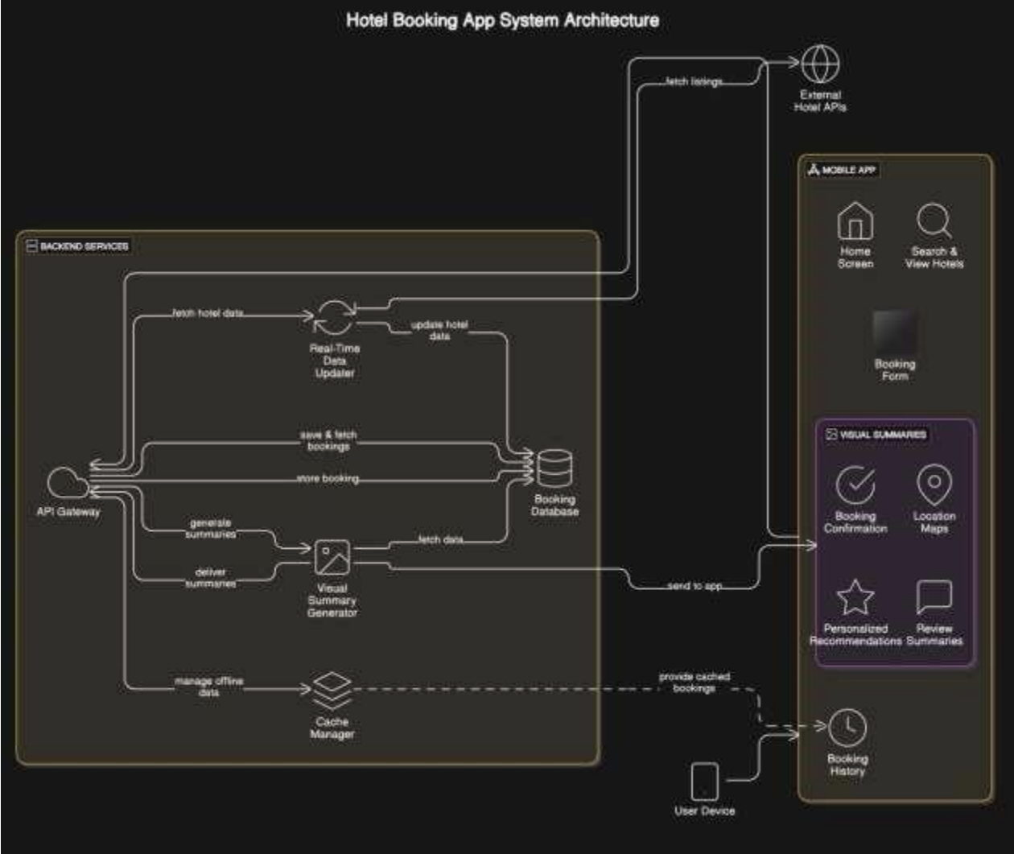
Architecture

Slide 8
System Requirements
TOOLS USED
• Android Studio: Used as the primary IDE for designing, developing, and testing the mobile application.
• Kotlin: Programming language used to implement the application logic and backend functionality.
• XML: Used for designing the front-end user interface layouts with Material Design elements.
• Room Database: Provides local data storage for storing booking history and user preferences.
• Google Maps API: Integrated to display user location and nearby hotels visually on a map.

Slide 9
Functional Description
• Hotel Search & Discovery Module: Enables users to search for hotels based on their current or selected location, retrieving listings with details such as name, price, rating, amenities, and availability.
• Booking Management Module: Allows users to view hotel details, select check-in/check-out dates, and complete bookings. It handles reservation logic and stores booking data locally and/or remotely.
• Location & Map Integration Module: Integrates with Google Maps API to display nearby hotels, provide directions, and support interactive map-based hotel selection.
• Booking History & Filter Module: Displays a list of previous bookings with filtering options based on date, location, or hotel name for easy record access and reference.
• UI/UX Module: Features a clean, intuitive user interface designed using Material Design principles, ensuring responsive layouts, smooth transitions, and an engaging user experience.

Slide 10
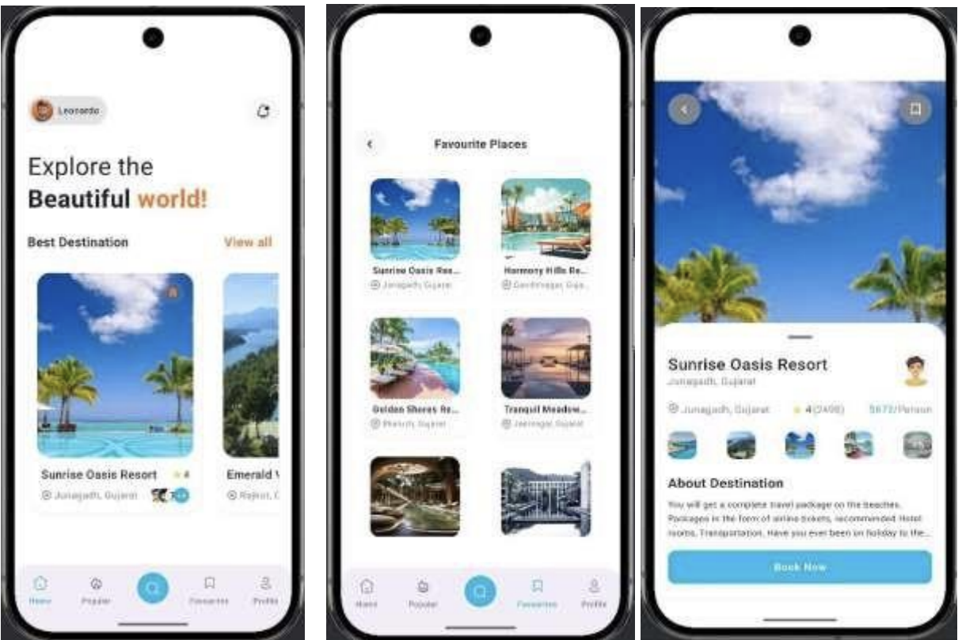
Implementation

Slide 11
Conclusions
SmartStay provides users with an intuitive and seamless way to discover and book hotels near their location. The app offers real-time hotel listings with detailed information on pricing, availability, and amenities, ensuring that users can easily find the perfect accommodation. With simple booking forms and a smooth reservation process, the app empowers users to plan their stays with ease. The interactive home screen and clear hotel summaries enhance the user experience, while the ability to view booking history and search past reservations ensures a personalized and efficient booking process. Whether you're traveling for business or leisure, SmartStay offers a convenient and reliable solution for hotel booking.

Slide 12
Future Enhancement
• Location-Based Recommendations: Suggest hotels based on the user's current or selected location.
• Hotel Wishlist: Save and compare hotels in a wishlist for future bookings.
• Payment Integration: Offer secure payment options for booking reservations directly through the app.
• Booking Confirmation Notifications: Send instant notifications for booking confirmations and reminders.
• Booking Modification & Cancellation: Allow users to modify or cancel their bookings with ease.

Slide 13
References
1)Android Developer Documentation
2)Mobile Game Design Best Practices (2024)
3)Room Database Documentation for Android

Slide 14
Queries…?

Slide 15
Demonstration

Slide 16
Thank You…!

